Slide 1
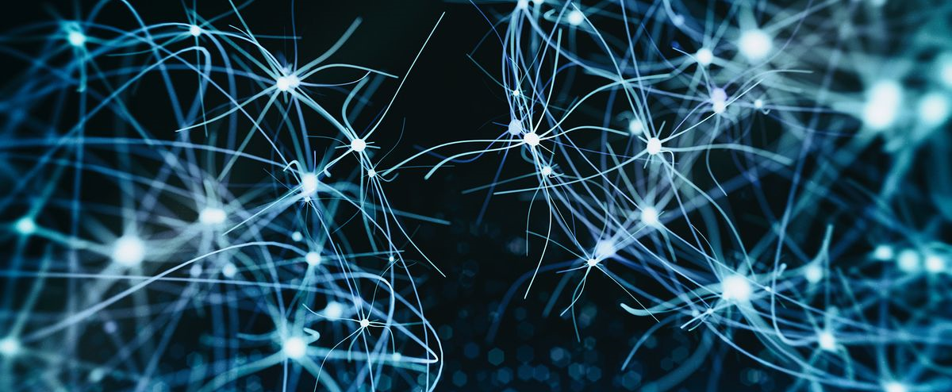

BMB3015 ARTIFICIAL INTELLIGENCE
MARKOV DECISION PROCESS
& REINFORCEMENT LEARNING

Slide 2
Content
Markov Decision Process (MDP)
Value iteration
Reinforcement Learning (RL)
Q-learning

Slide 3
Planning under Uncertainty
Policy strategy is a solution to the problems of tree search algorithms
Complex branching factor in stochastic states
Revisited states
 | DETERMINISTIC | STOCHASTIC
FULLY-OBSERVABLE | A*, DFS, BFS | MDP
PARTIALLY-OBSERVABLE |  | Partially Observable MDP (POMDP)

Slide 4
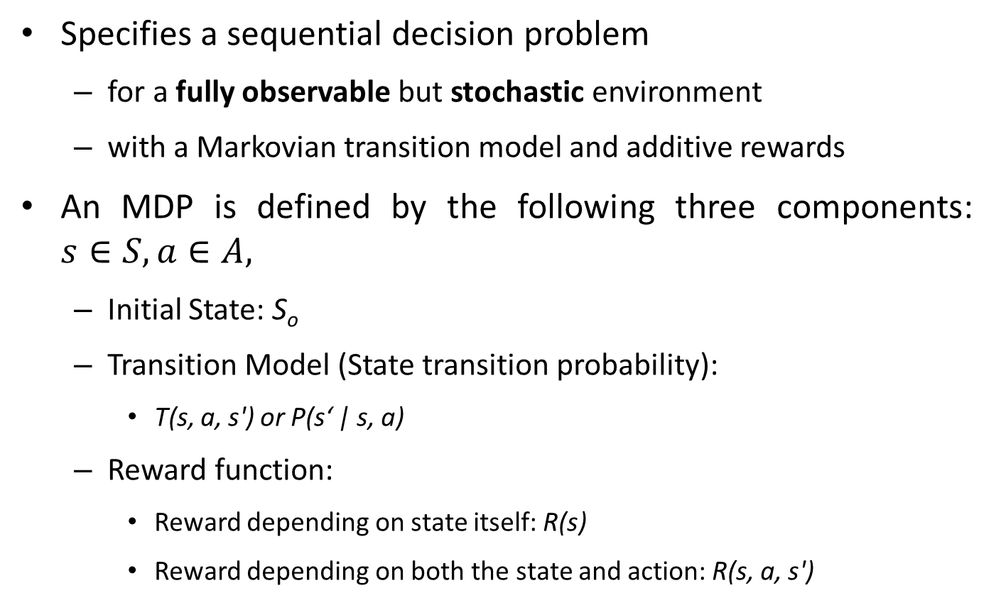
Markov Decision Process
Specifies a sequential decision problem
for a fully observable but stochastic environment
with a Markovian transition model and additive rewards
An MDP is defined by the following three components: $s∈S, a∈A,$
Initial State: S_{o}
Transition Model (State transition probability):
T(s, a, s') or P(s‘ | s, a)
Reward function:
Reward depending on state itself: R(s)
Reward depending on both the state and action: R(s, a, s')
Succ(s,a)
Cost(s,a)

Slide 5
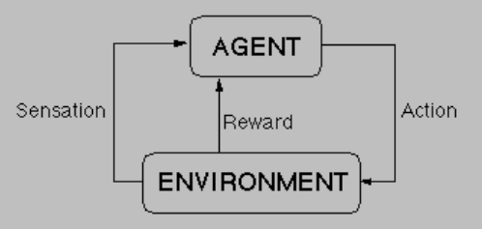
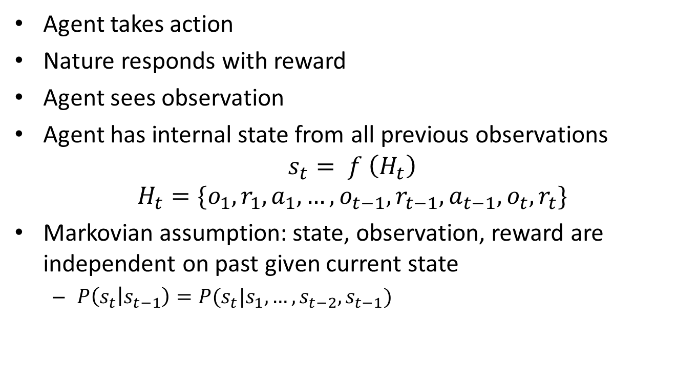
Sequential Decision Making
Agent takes action
Nature responds with reward
Agent sees observation
Agent has internal state from all previous observations
$$s_{t}= f \left(H_{t}\right)$$
$$H_{t}=\{o_{1},r_{1},a_{1},…,o_{t−1},r_{t−1},a_{t−1},o_{t},r_{t}\}$$
Markovian assumption: state, observation, reward are independent on past given current state
$P\left(s_{t} | s_{t−1}\right)=P(s_{t}|s_{1},…,s_{t−2},s_{t−1})$

Slide 6
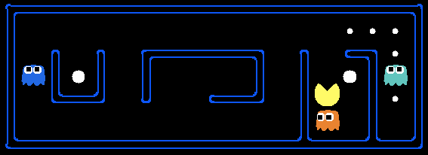
Markovian?
State? Actions? Rewards?

Slide 7
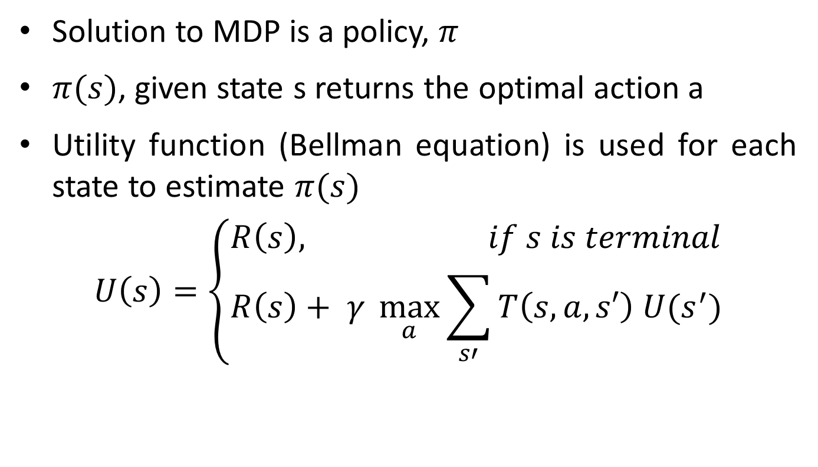
MDP Solution
Solution to MDP is a policy, $π$
$π(s)$, given state s returns the optimal action a
Utility function (Bellman equation) is used for each state to estimate $π(s)$
$$U\left(s\right)=\left\{\begin{aligned}R\left(s\right), if s is terminal \\ R\left(s\right)+ γ \max_{a}{\sum_{s′}{T\left(s,a,s′\right) U(s^{′})}}\end{aligned}\right.$$

Slide 8
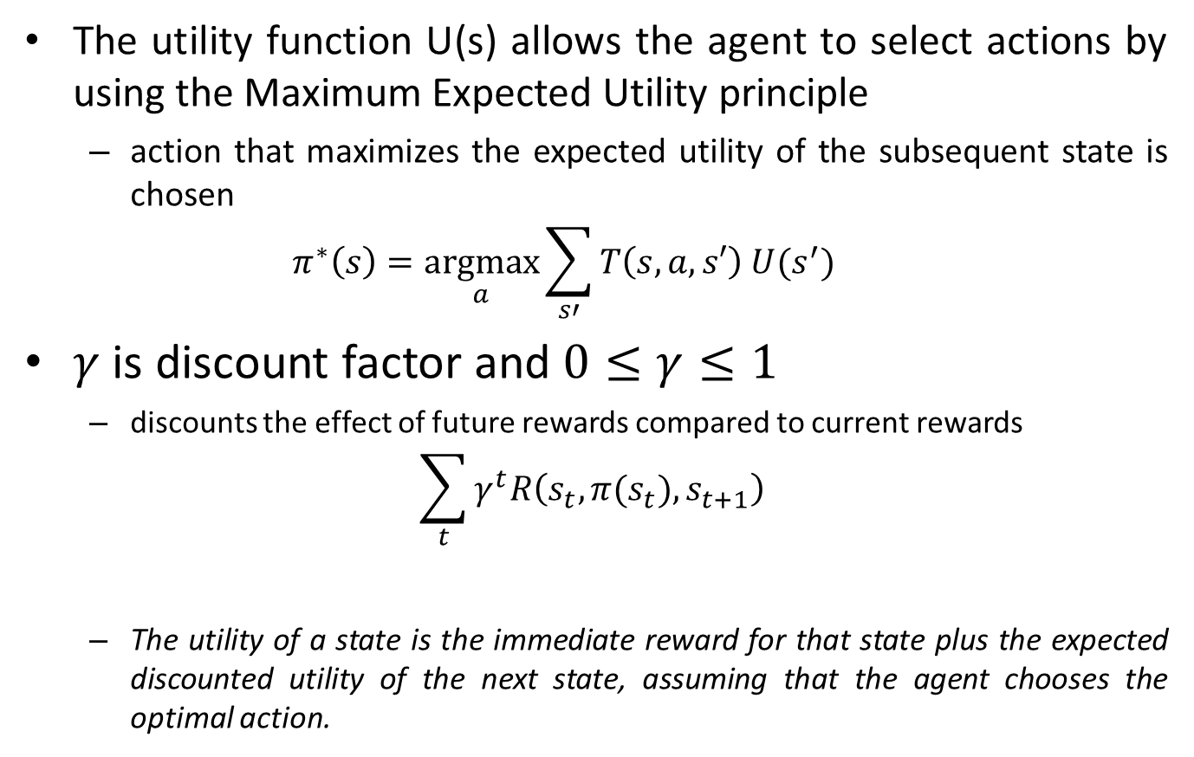

MDP Solution
The utility function U(s) allows the agent to select actions by using the Maximum Expected Utility principle
action that maximizes the expected utility of the subsequent state is chosen
$$π^{∗}\left(s\right)=\underset{a}{argmax}{\sum_{s′}{T\left(s,a,s′\right) U(s^{′})}}$$
$γ$ is discount factor and $0≤γ≤1$
discounts the effect of future rewards compared to current rewards
$$\sum_{t}{γ^{t}R\left(s_{t},π(s_{t}),s_{t+1}\right)}$$
The utility of a state is the immediate reward for that state plus the expected discounted utility of the next state, assuming that the agent chooses the optimal action.
$$a_{t}$$
Notes:
Now, if the utility of a state is the expected sum of discounted rewards from that point onwards,
then there is a direct relationship between the utility of a state and the utility of its
neighbors: the utility of a state is the immediate reward for that state plus the expected discounted
utility of the next state, assuming that the agent chooses the optimal action

Slide 9
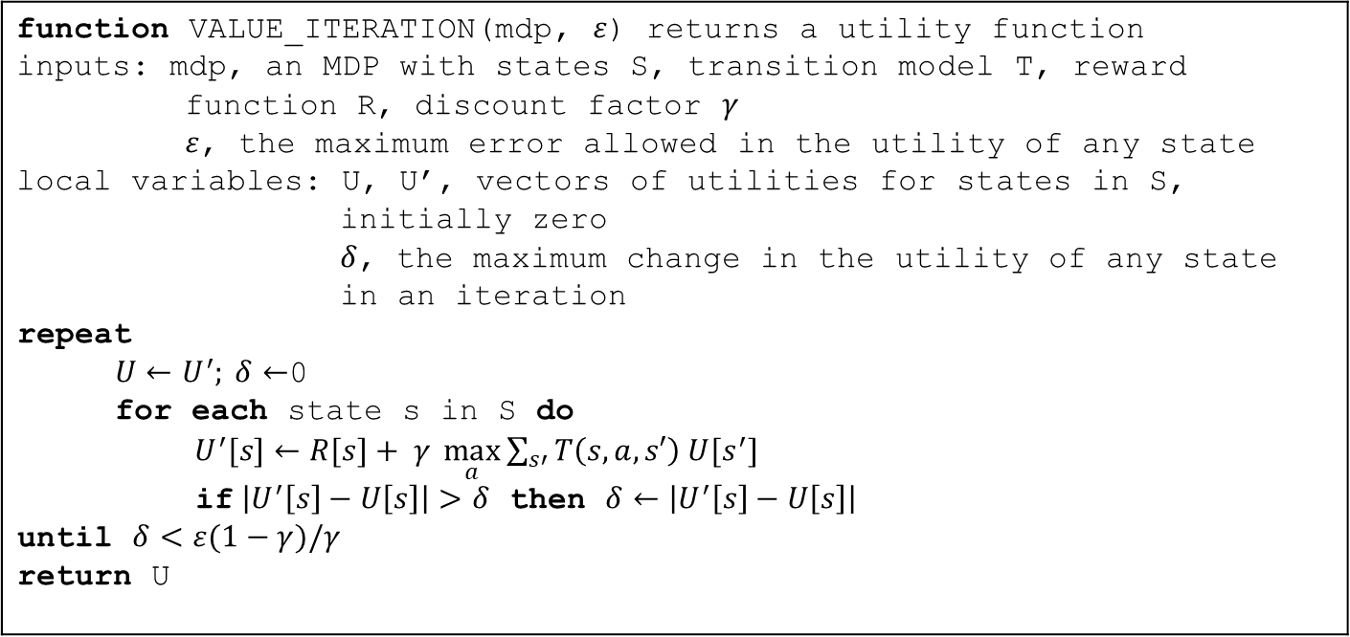
Value Iteration Algorithm
An iterative algorithm to compute the optimal utility function
function VALUE_ITERATION(mdp, $ε$) returns a utility function inputs: mdp, an MDP with states S, transition model T, reward function R, discount factor $γ$ $ε$, the maximum error allowed in the utility of any state local variables: U, U’, vectors of utilities for states in S, initially zero $δ$, the maximum change in the utility of any state in an iteration repeat $U←U^{′}; δ←$0 for each state s in S do $U^{′}[s]←R[s]+ γ \max_{a}{\sum_{s′}{T\left(s,a,s′\right) U[s^{′}]}}$ if $\left|U^{′}\left[s\right]−U\left[s\right]\right|>δ$ then $δ←\left|U^{′}\left[s\right]−U\left[s\right]\right|$ until $δ<ε(1−γ)/γ$ return U

Slide 10
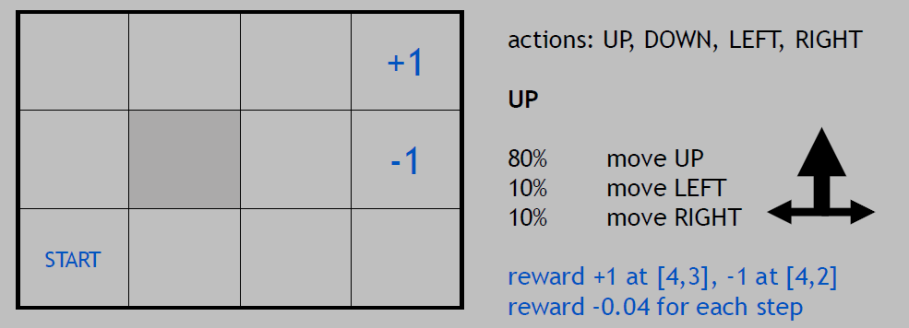
MDP Example: Robot in a Room
Intended outcome occurs with probability 0.8, but with probability 0.1 if the agent moves at right angles to the intended direction
A collision with a wall results in no movement.
The two terminal states have reward +1 and -1, respectively.
Other states have a reward of -0.04.
What is the solution?
1 2 3 4
States
a (3)
b (2)
c (1)
Rewards

Slide 11
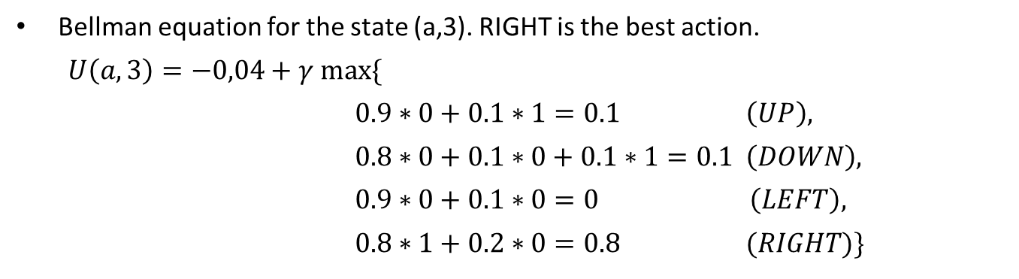
MDP Example: Robot in a Room
Bellman equation for the state (a,3). RIGHT is the best action.
$U\left(a,3\right)=−0,04+γ max⁡\{$
$0.9∗0+0.1∗1=0.1 \left(UP\right),$
$0.8∗0+0.1∗0+0.1∗1=0.1 \left(DOWN\right),$
$0.9∗0+0.1∗0=0 \left(LEFT\right),$
$0.8∗1+0.2∗0=0.8 (RIGHT)\}$
Initially utility values for the states are 0.
1 2 3 4
a (3)
b (2)
c (1)
Rewards

Slide 12
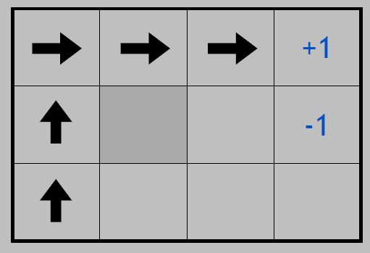
MDP Example: Optimal Policies
Is this a solution?
only if actions are deterministic
not in this case (actions are stochastic)
solution/policy
mapping from each state to an action

Slide 13
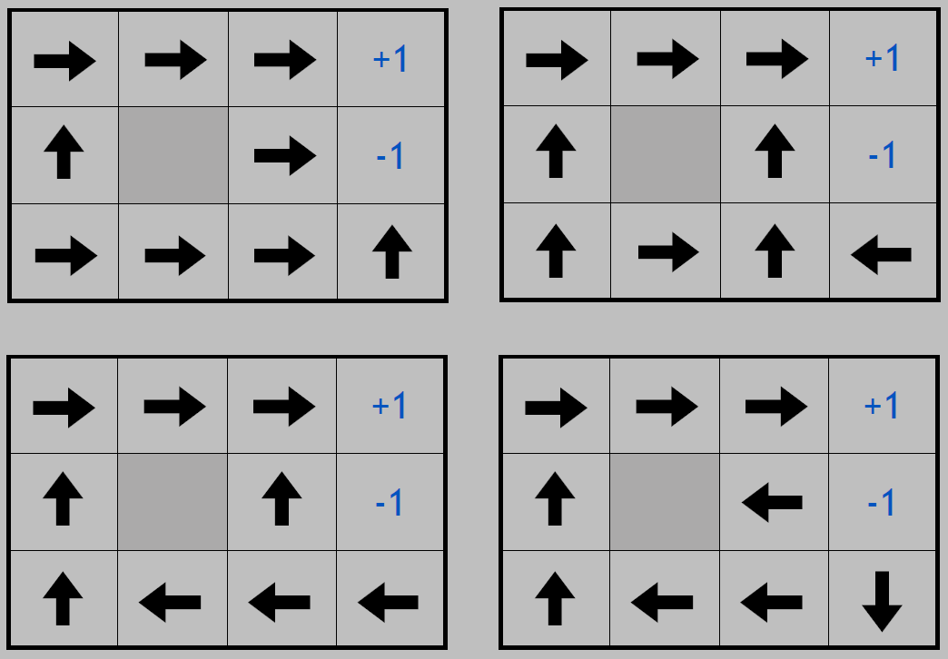
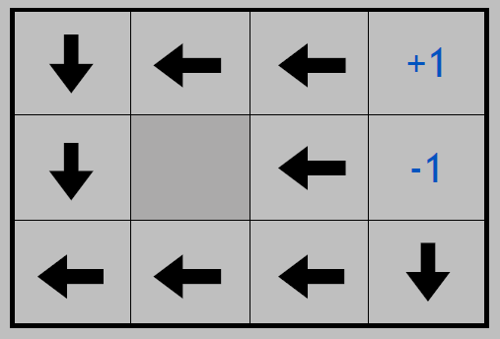
MDP Example: Optimal Policies
Reward for each state affects the policy.
reward = -2
reward = -0.1
reward = +0.01
reward = -0.04
reward = -0.01

Slide 14
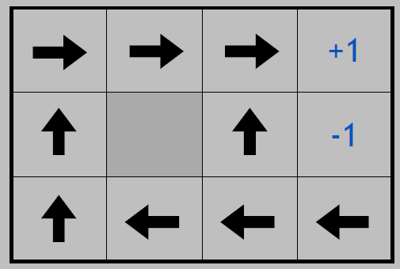
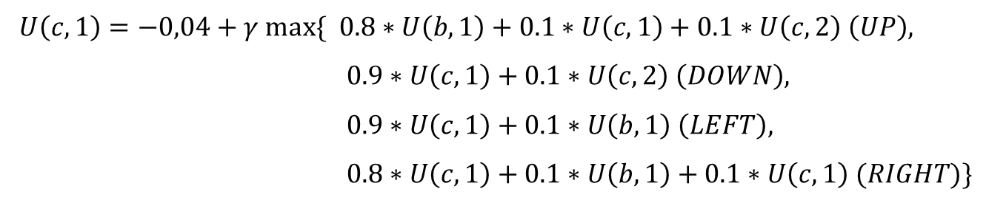
MDP Example: Converged World
Bellman equation for the state (c,1).
$U\left(c,1\right)=−0,04+γ max⁡\{$ $0.8∗U\left(b,1\right)+0.1∗U\left(c,1\right)+0.1∗U\left(c,2\right) \left(UP\right),$
$0.9∗U\left(c,1\right)+0.1∗U\left(c,2\right) \left(DOWN\right),$
$0.9∗U\left(c,1\right)+0.1∗U\left(b,1\right) \left(LEFT\right),$
$0.8∗U\left(c,1\right)+0.1∗U\left(b,1\right)+0.1∗U\left(c,1\right) (RIGHT)\}$
1 2 3 4
0.812
0.868
0.918
a
b
c
Up is the best possible action in state (c,1).
0.762
0.655
0.705
0.660
0.611
0.388

Slide 15
Learning
Learning is essential for unknown environments,
i.e., when designer lacks omniscience
Learning is useful as a system construction method,
i.e., expose the agent to reality rather than trying to write it down
Learning modifies the agent's decision mechanisms to improve performance

Slide 16
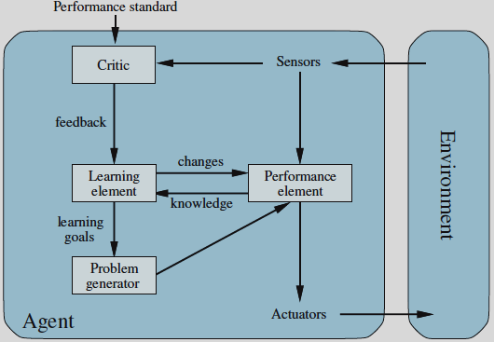
Learning Agents

Slide 17
Learning Element
Design of a learning element is affected by
what type of performance element is used
which functional component is to be learned
how that functional component is represented
what kind of feedback is available
Classification of learning algorithms with respect to type of feedback:
Supervised learning:
correct answers for each data sample
Unsupervised learning:
correct answers not given, learns from data itself
Reinforcement learning:
occasional rewards

Slide 18
Example Scenarios
Performance element | Component | Representation | Feedback
Alpha-beta search | Evaluation func. | Weighted linear func. | Win/Loss
Logical agent | Transition model | Successor-state axioms | Outcome
Utility-based agent | Transition model | Dynamic Bayes net | Outcome
Simple reflex agent | Percept-action func. | Neural net | Correct action

Slide 19
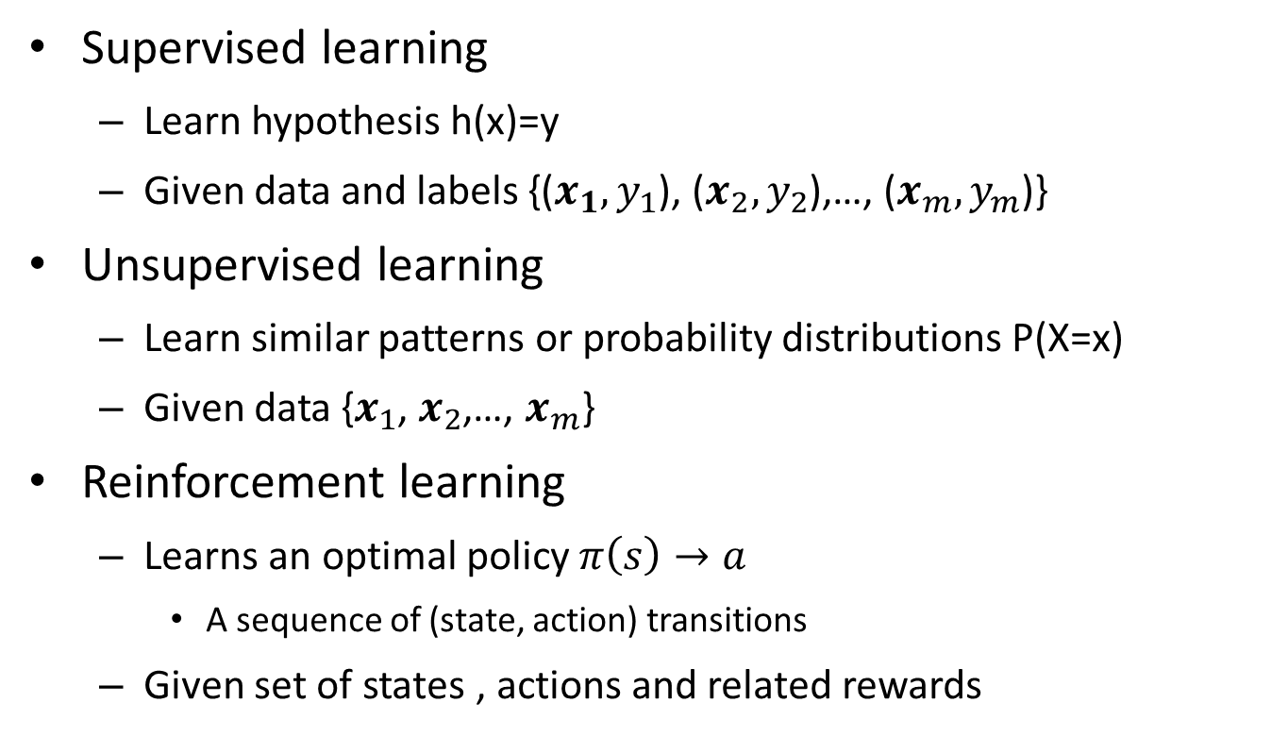
Learning Methods Classification
Supervised learning
Learn hypothesis h(x)=y
Given data and labels {($x_{1},y_{1}$), ($x_{2},y_{2}$),…, ($x_{m},y_{m}$)}
Unsupervised learning
Learn similar patterns or probability distributions P(X=x)
Given data {$x_{1}$, $x_{2}$,…, $x_{m}$}
Reinforcement learning
Learns an optimal policy $π\left(s\right)→a$
A sequence of (state, action) transitions
Given set of states , actions and related rewards

Slide 20
Learning Methods Overview
Classification methods
Logistic regression
Decision trees
K-nearest neighbors
Artifical neural networks
Learning vector quantization
Support vector machines
Clustering methods:
Hieararchical clustering
K-means
Self organizing maps –SOM
Gaussian mixture models
Regression methods
Simple linear regression
Decision (regression) trees
K-nearest neighbours
Artificial neural networks
Reinforcement learning
Temporal difference learning
Q-learning
Anomaly detection
Recommendation systems
Collaborative filtering
Association rules
Notes:
Association Rules
Market analysis
Which products are sold together?
Shelf arrangement
Which products should be replaced together?
Promotions
Which products should be given along with what?

Slide 21
MDP versus RL
MDP, POMDP
PLANNING
UNCERTAINTY
LEARNING
RL

Slide 22
MDP versus RL
MDP
knows the state rewards and transition probabilities
optimal policy can be inferred with value iteration
RL
can learn optimal policy without knowing state rewards and transition probabilities
performs exploration in the environment
has no supervisor but only a reward signal
feedback is delayed until an actual reward or punishment
Time really matters (sequential)
Agent’s actions affect the subsequent data it receives

Slide 23
RL Examples
Fly stunt maneuvers in a helicopter
Defeat the world champion at Backgammon (& Go)
Control a power station
Make a humanoid robot walk
Play Atari games better than humans
Notes:
Stunt: akrobasi

Slide 24
Reward Hypothesis
Agent goal: maximize cumulative reward
Hypothesis: All goals can be described by the maximization of the expected cumulative reward (?)
Fly stunt maneuvers in a helicopter
+ reward for following desired trajectory − reward for crashing
Defeat the world champion at Backgammon (& Go)
+/− reward for winning/losing a game
Make a humanoid robot walk
+ reward for forward motion − reward for falling over
Play Atari games better than humans
+/− reward for increasing/decreasing score

Slide 25
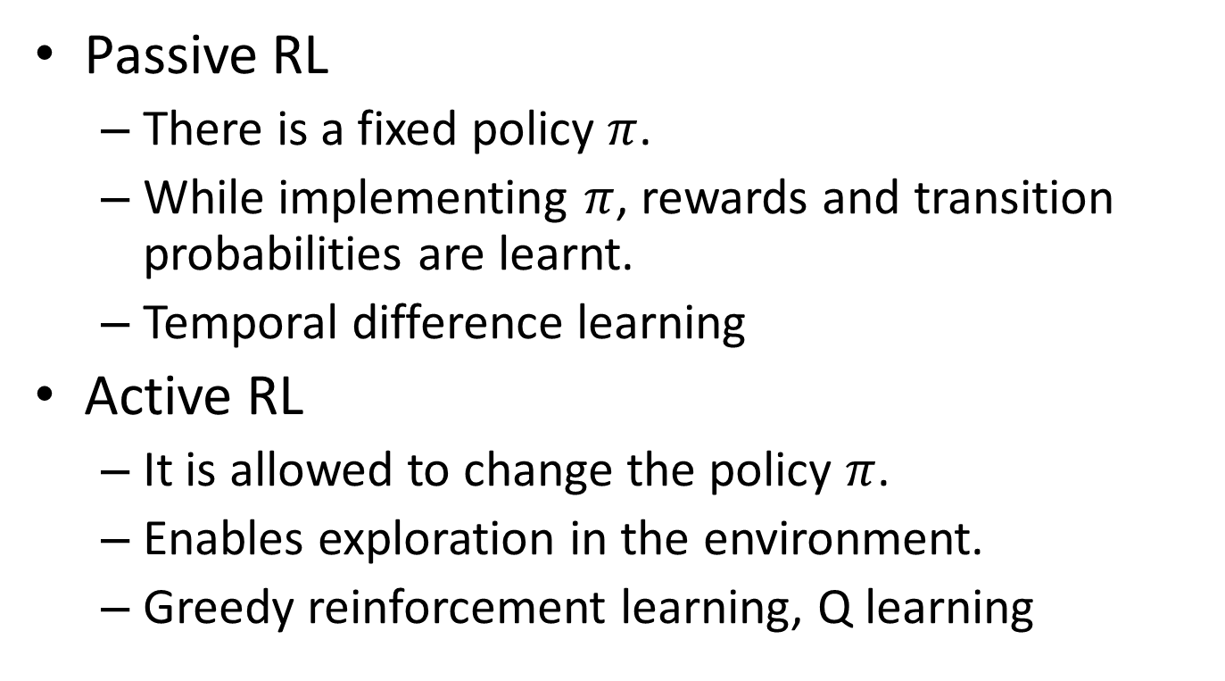
Active and Passive RL
Passive RL
There is a fixed policy $π$.
While implementing $π$, rewards and transition probabilities are learnt.
Temporal difference learning
Active RL
It is allowed to change the policy $π$.
Enables exploration in the environment.
Greedy reinforcement learning, Q learning

Slide 26
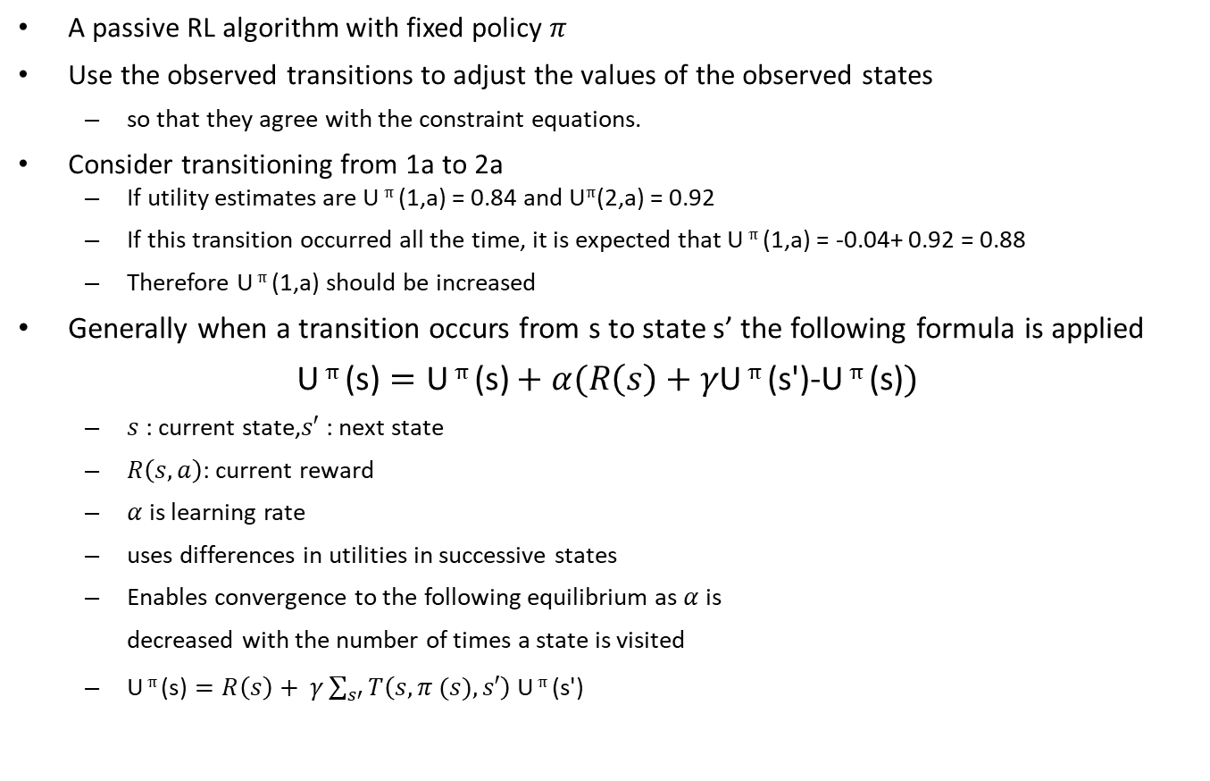
TD Learning
A passive RL algorithm with fixed policy $π$
Use the observed transitions to adjust the values of the observed states
so that they agree with the constraint equations.
Consider transitioning from 1a to 2a
If utility estimates are U $π$ (1,a) = 0.84 and U$π$(2,a) = 0.92
If this transition occurred all the time, it is expected that U $π$ (1,a) = -0.04+ 0.92 = 0.88
Therefore U $π$ (1,a) should be increased
Generally when a transition occurs from s to state s’ the following formula is applied
$$\text{U} π \text{(}\text{s}\text{)}=\text{U} π \text{(}\text{s}\text{)}+α(R\left(s\right)+γ\text{U} π \text{(}\text{s}\text{'}\text{)}\text{-}\text{U} π \text{(}\text{s}\text{)})$$
$s$: current state,$s′$: next state
$R\left(s,a\right)$: current reward
$α$ is learning rate
uses differences in utilities in successive states
Enables convergence to the following equilibrium as $α$ is
decreased with the number of times a state is visited
$\text{U} π \text{(}\text{s}\text{)}=R\left(s\right)+ γ\sum_{s′}{T\left(s,π (s),s′\right) \text{U} π \text{(}\text{s}\text{'}\text{)}}$
1 2 3 4
a (3)
b (2)
c (1)

Slide 27
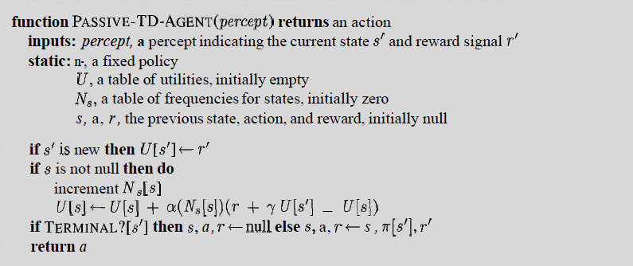


TD Learning Algorithm
Utility estimates were learnt through temporal differences
$$π$$
$$s^{′},$$

Slide 28
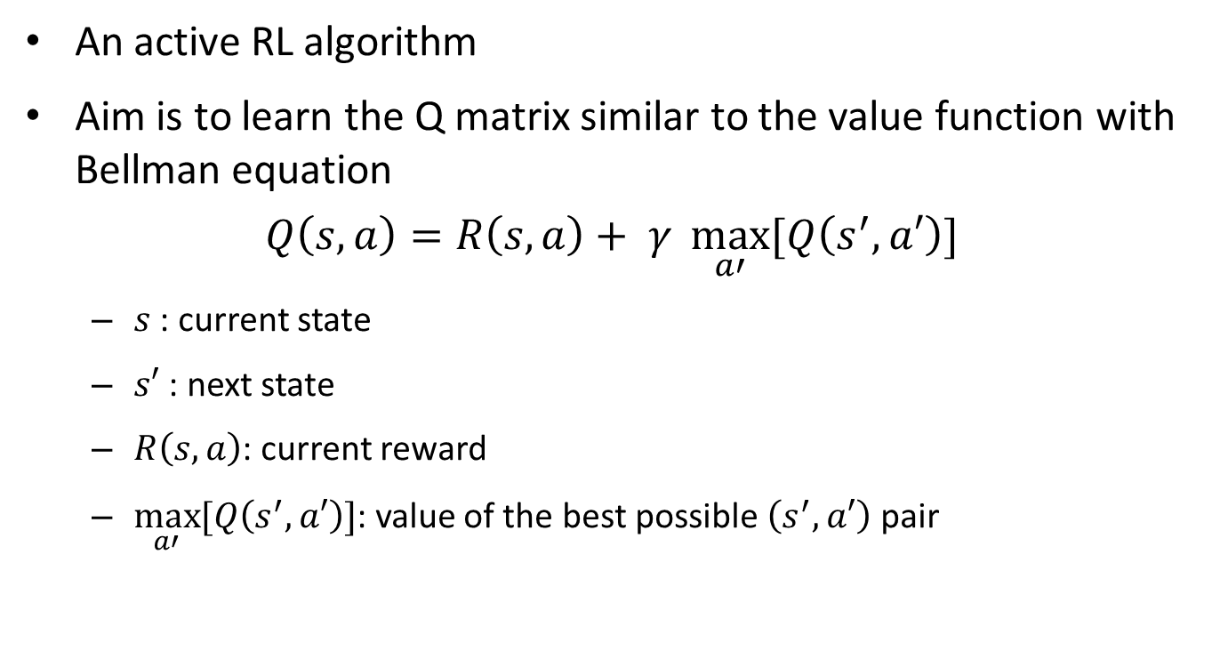
Q Learning
An active RL algorithm
Aim is to learn the Q matrix similar to the value function with Bellman equation
$$Q\left(s, a\right)=R\left(s,a\right)+ γ \max_{a′}{[Q\left(s^{′},a′\right)]}$$
$s$: current state
$s′$: next state
$R\left(s,a\right)$: current reward
$\max_{a′}{[Q\left(s^{′},a′\right)]}$: value of the best possible $\left(s^{′},a′\right)$ pair

Slide 29
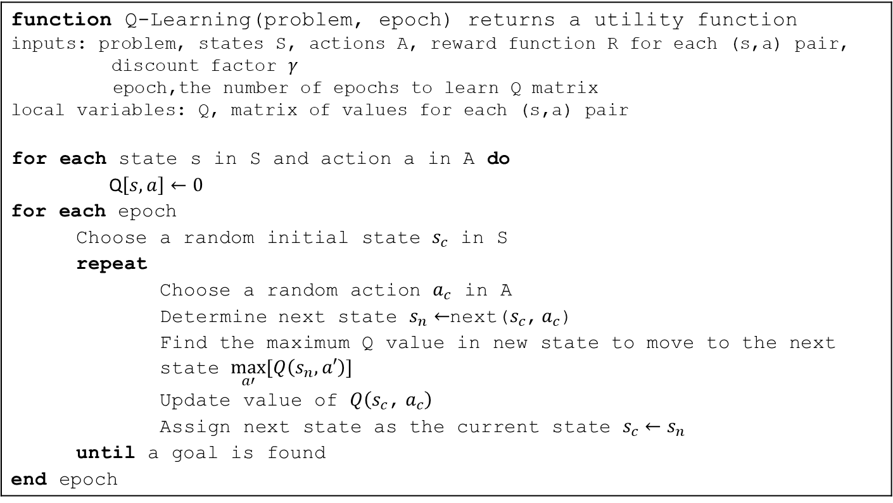
Q Learning Algorithm
An iterative algorithm to find optimal policy.
function Q-Learning(problem, epoch) returns a utility function inputs: problem, states S, actions A, reward function R for each (s,a) pair, discount factor $γ$ epoch,the number of epochs to learn Q matrix local variables: Q, matrix of values for each (s,a) pair for each state s in S and action a in A do Q$\left[s,a\right]←0$ for each epoch Choose a random initial state $s_{c}$ in S repeat Choose a random action $a_{c}$ in A Determine next state $s_{n}←$next($s_{c}$, $a_{c}$) Find the maximum Q value in new state to move to the next state $\max_{a′}{[Q\left(s_{n},a′\right)]}$ Update value of $Q\left(s_{c}\text{,} a_{c}\right)$ Assign next state as the current state $s_{c}←s_{n}$ until a goal is found end epoch

Slide 30
Q-Learning Example
A moving robot problem
States are rooms, goal is to reach F
Actions are moving from a room to another if a door exists
Initially unknown reward or punishments
Known rewards
A
A
B
100
100
F*
0
B
F
0
0
0
0
0
E
100
D
C
E
0
D
0
C
0
0
F*
Door from E to F

Slide 31
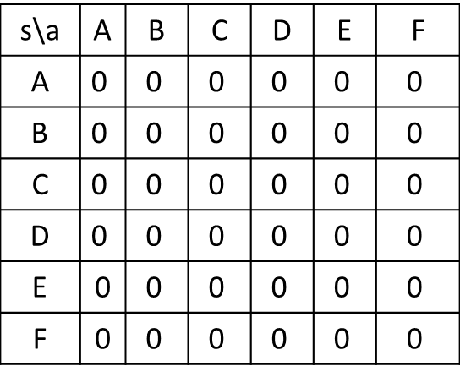
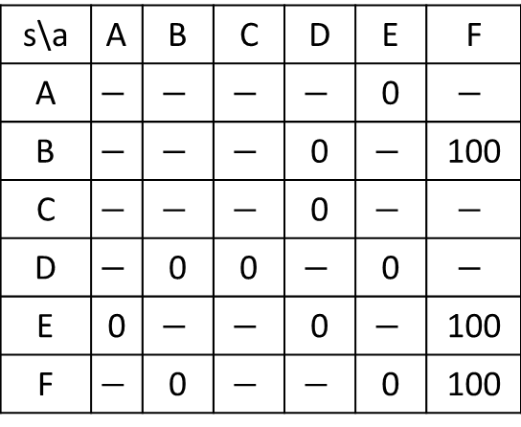
Q-Learning Example: Learning Q values
Reward matrix and Q matrix is generated for each (s,a) pair.
Q matrix is initially zero, and its values are learnt through exploration.
Let’s say robot starts from B, and randomly chooses to go F.
Reward Matrix
Q Matrix
s\a | A | B | C | D | E | F
A | $$−$$ | $$−$$ | $$−$$ | $$−$$ | 0 | $$−$$
B | $$−$$ | $$−$$ | $$−$$ | 0 | $$−$$ | 100
C | $$−$$ | $$−$$ | $$−$$ | 0 | $$−$$ | $$−$$
D | $$−$$ | 0 | 0 | $$−$$ | 0 | $$−$$
E | 0 | $$−$$ | $$−$$ | 0 | $$−$$ | 100
F | $$−$$ | 0 | $$−$$ | $$−$$ | 0 | 100
s\a | A | B | C | D | E | F
A | $$\text{0}$$ | $$\text{0}$$ | $$\text{0}$$ | $$\text{0}$$ | $$\text{0}$$ | $$\text{0}$$
B | $$\text{0}$$ | $$\text{0}$$ | $$\text{0}$$ | $$\text{0}$$ | $$\text{0}$$ | $$\text{0}$$
C | $$\text{0}$$ | $$\text{0}$$ | $$\text{0}$$ | $$\text{0}$$ | $$\text{0}$$ | $$\text{0}$$
D | $$\text{0}$$ | $$\text{0}$$ | $$\text{0}$$ | $$\text{0}$$ | $$\text{0}$$ | $$\text{0}$$
E | 0 | $$\text{0}$$ | $$\text{0}$$ | $$\text{0}$$ | $$\text{0}$$ | $$\text{0}$$
F | 0 | $$\text{0}$$ | $$\text{0}$$ | $$\text{0}$$ | $$\text{0}$$ | $$\text{0}$$

Slide 32
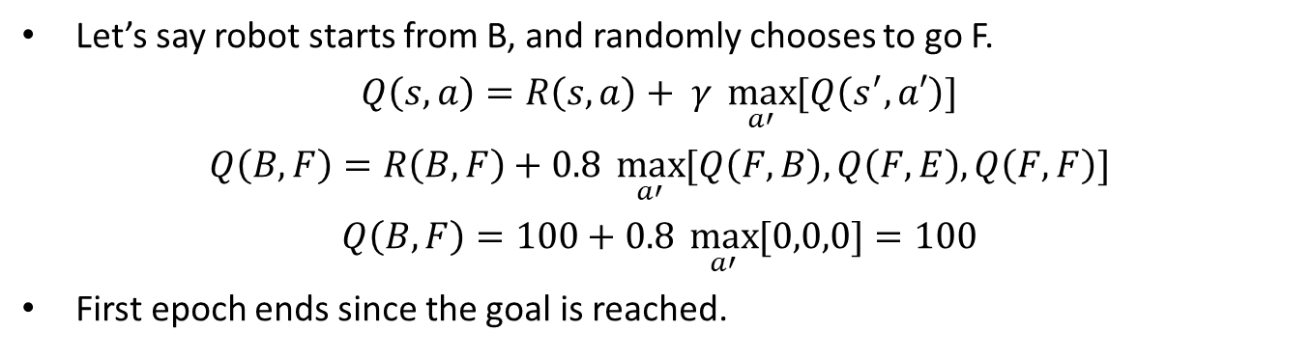
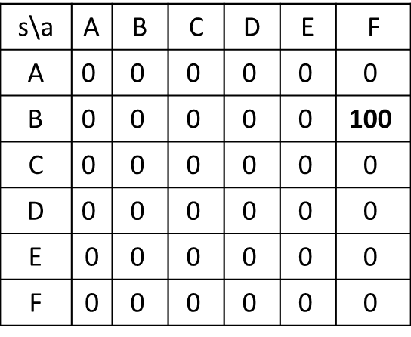
Q-Learning Example: Learning Q values
Let’s say robot starts from B, and randomly chooses to go F.
$$Q\left(s, a\right)=R\left(s,a\right)+ γ \max_{a′}{[Q\left(s^{′},a′\right)]}$$
$$Q\left(B, F\right)=R\left(B,F\right)+0.8 \max_{a′}{[Q\left(F,B\right),Q\left(F,E\right),Q\left(F,F\right)]}$$
$$Q\left(B, F\right)=100+0.8 \max_{a′}{[0,0,0]}=100$$
First epoch ends since the goal is reached.
Reward Matrix
Q Matrix
s\a | A | B | C | D | E | F
A | $$−$$ | $$−$$ | $$−$$ | $$−$$ | 0 | $$−$$
B | $$−$$ | $$−$$ | $$−$$ | 0 | $$−$$ | 100
C | $$−$$ | $$−$$ | $$−$$ | 0 | $$−$$ | $$−$$
D | $$−$$ | 0 | 0 | $$−$$ | 0 | $$−$$
E | 0 | $$−$$ | $$−$$ | 0 | $$−$$ | 100
F | $$−$$ | 0 | $$−$$ | $$−$$ | 0 | 100
s\a | A | B | C | D | E | F
A | $$\text{0}$$ | $$\text{0}$$ | $$\text{0}$$ | $$\text{0}$$ | $$\text{0}$$ | $$\text{0}$$
B | $$\text{0}$$ | $$\text{0}$$ | $$\text{0}$$ | $$\text{0}$$ | $$\text{0}$$ | $$\text{100}$$
C | $$\text{0}$$ | $$\text{0}$$ | $$\text{0}$$ | $$\text{0}$$ | $$\text{0}$$ | $$\text{0}$$
D | $$\text{0}$$ | $$\text{0}$$ | $$\text{0}$$ | $$\text{0}$$ | $$\text{0}$$ | $$\text{0}$$
E | 0 | $$\text{0}$$ | $$\text{0}$$ | $$\text{0}$$ | $$\text{0}$$ | $$\text{0}$$
F | 0 | $$\text{0}$$ | $$\text{0}$$ | $$\text{0}$$ | $$\text{0}$$ | $$\text{0}$$

Slide 33
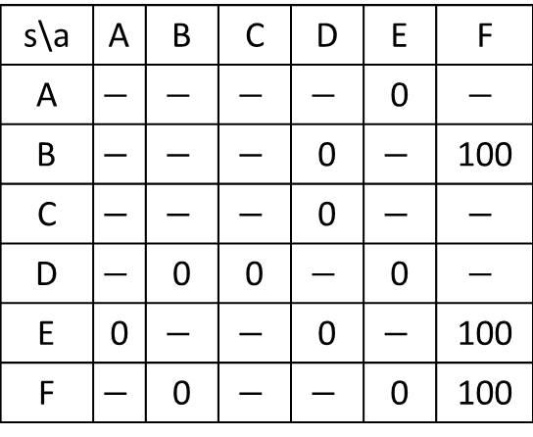
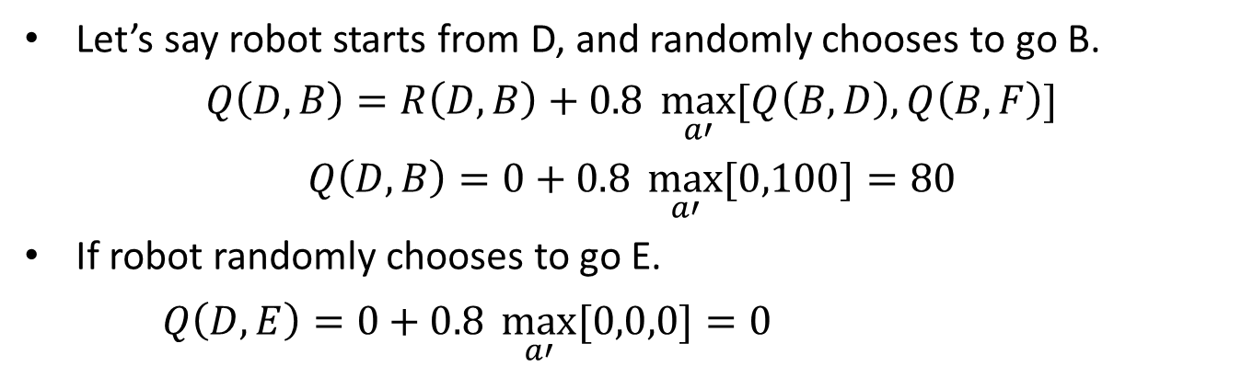
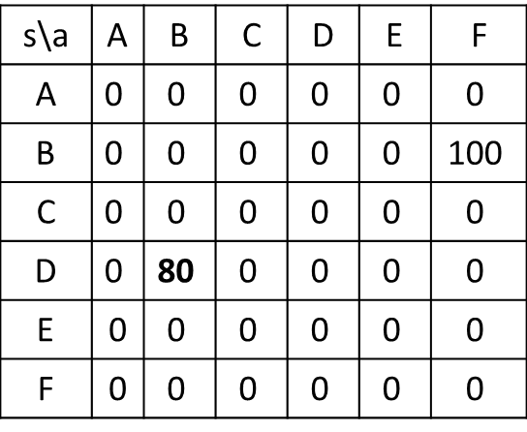
Q-Learning Example: Learning Q values
Let’s say robot starts from D, and randomly chooses to go B.
$$Q\left(D, B\right)=R\left(D,B\right)+0.8 \max_{a′}{[Q\left(B,D\right),Q\left(B,F\right)]}$$
$$Q\left(D, B\right)=0+0.8 \max_{a′}{[0,100]}=80$$
If robot randomly chooses to go E.
$Q\left(D, E\right)=0+0.8 \max_{a′}{[0,0,0]}=0$
Reward Matrix
Q Matrix
s\a | A | B | C | D | E | F
A | $$−$$ | $$−$$ | $$−$$ | $$−$$ | 0 | $$−$$
B | $$−$$ | $$−$$ | $$−$$ | 0 | $$−$$ | 100
C | $$−$$ | $$−$$ | $$−$$ | 0 | $$−$$ | $$−$$
D | $$−$$ | 0 | 0 | $$−$$ | 0 | $$−$$
E | 0 | $$−$$ | $$−$$ | 0 | $$−$$ | 100
F | $$−$$ | 0 | $$−$$ | $$−$$ | 0 | 100
s\a | A | B | C | D | E | F
A | $$\text{0}$$ | $$\text{0}$$ | $$\text{0}$$ | $$\text{0}$$ | $$\text{0}$$ | $$\text{0}$$
B | $$\text{0}$$ | $$\text{0}$$ | $$\text{0}$$ | $$\text{0}$$ | $$\text{0}$$ | $$\text{100}$$
C | $$\text{0}$$ | $$\text{0}$$ | $$\text{0}$$ | $$\text{0}$$ | $$\text{0}$$ | $$\text{0}$$
D | $$\text{0}$$ | $$\text{80}$$ | $$\text{0}$$ | $$\text{0}$$ | $$\text{0}$$ | $$\text{0}$$
E | 0 | $$\text{0}$$ | $$\text{0}$$ | $$\text{0}$$ | $$\text{0}$$ | $$\text{0}$$
F | 0 | $$\text{0}$$ | $$\text{0}$$ | $$\text{0}$$ | $$\text{0}$$ | $$\text{0}$$

Slide 34
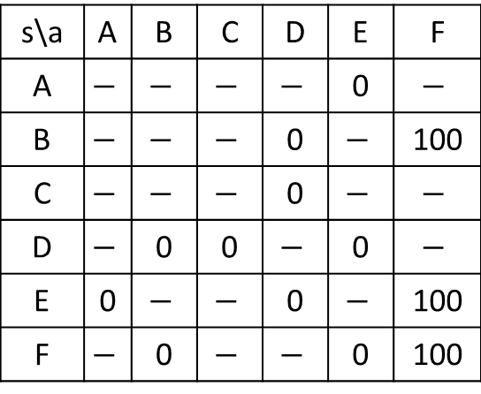
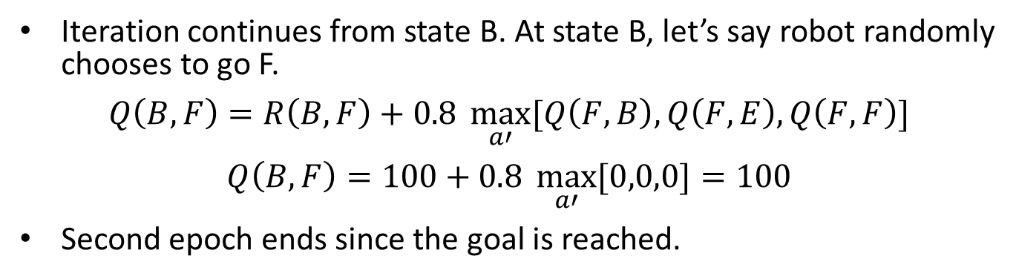
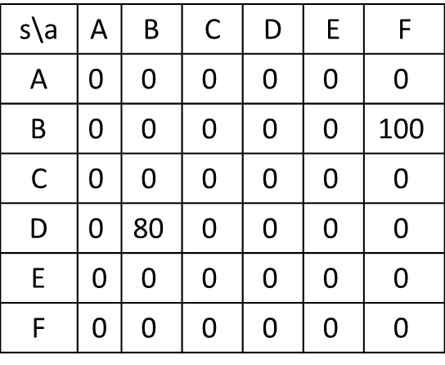
Q-Learning Example: Learning Q values
Iteration continues from state B. At state B, let’s say robot randomly chooses to go F.
$$Q\left(B, F\right)=R\left(B,F\right)+0.8 \max_{a′}{[Q\left(F,B\right),Q\left(F,E\right),Q\left(F,F\right)]}$$
$$Q\left(B, F\right)=100+0.8 \max_{a′}{[0,0,0]}=100$$
Second epoch ends since the goal is reached.
Reward Matrix
Q Matrix
s\a | A | B | C | D | E | F
A | $$−$$ | $$−$$ | $$−$$ | $$−$$ | 0 | $$−$$
B | $$−$$ | $$−$$ | $$−$$ | 0 | $$−$$ | 100
C | $$−$$ | $$−$$ | $$−$$ | 0 | $$−$$ | $$−$$
D | $$−$$ | 0 | 0 | $$−$$ | 0 | $$−$$
E | 0 | $$−$$ | $$−$$ | 0 | $$−$$ | 100
F | $$−$$ | 0 | $$−$$ | $$−$$ | 0 | 100
s\a | A | B | C | D | E | F
A | $$\text{0}$$ | $$\text{0}$$ | $$\text{0}$$ | $$\text{0}$$ | $$\text{0}$$ | $$\text{0}$$
B | $$\text{0}$$ | $$\text{0}$$ | $$\text{0}$$ | $$\text{0}$$ | $$\text{0}$$ | $$\text{100}$$
C | $$\text{0}$$ | $$\text{0}$$ | $$\text{0}$$ | $$\text{0}$$ | $$\text{0}$$ | $$\text{0}$$
D | $$\text{0}$$ | $$\text{80}$$ | $$\text{0}$$ | $$\text{0}$$ | $$\text{0}$$ | $$\text{0}$$
E | 0 | $$\text{0}$$ | $$\text{0}$$ | $$\text{0}$$ | $$\text{0}$$ | $$\text{0}$$
F | 0 | $$\text{0}$$ | $$\text{0}$$ | $$\text{0}$$ | $$\text{0}$$ | $$\text{0}$$

Slide 35
Q-Learning Example: After Covergence
When Q learning algorithm converges, optimal policy is learnt.
For any state in the problem optimal action can be found.
Learnt rewards
A
100
100
A
B
F*
64
B
F
80
80
80
64
80
E
100
E
D
C
64
64
D
C
80
51
F*
Door from E to F

Slide 36
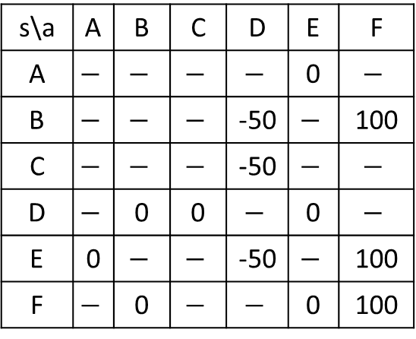
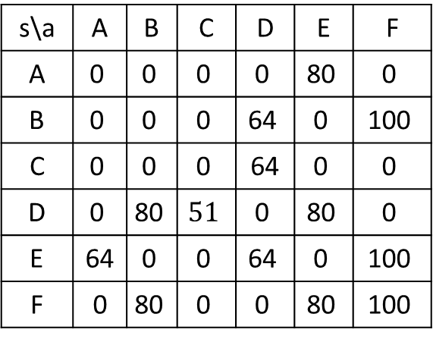
Revision of Reward Matrix
s\a | A | B | C | D | E | F
A | $$−$$ | $$−$$ | $$−$$ | $$−$$ | 0 | $$−$$
B | $$−$$ | $$−$$ | $$−$$ | -50 | $$−$$ | 100
C | $$−$$ | $$−$$ | $$−$$ | -50 | $$−$$ | $$−$$
D | $$−$$ | 0 | 0 | $$−$$ | 0 | $$−$$
E | 0 | $$−$$ | $$−$$ | -50 | $$−$$ | 100
F | $$−$$ | 0 | $$−$$ | $$−$$ | 0 | 100
A
B
F*
Revised
Reward Matrix
E
D
C
s\a | A | B | C | D | E | F
A | $$\text{0}$$ | $$\text{0}$$ | $$\text{0}$$ | $$\text{0}$$ | $$\text{80}$$ | $$\text{0}$$
B | $$\text{0}$$ | $$\text{0}$$ | $$\text{0}$$ | $$\text{64}$$ | $$\text{0}$$ | $$\text{100}$$
C | $$\text{0}$$ | $$\text{0}$$ | $$\text{0}$$ | 64 | $$\text{0}$$ | $$\text{0}$$
D | $$\text{0}$$ | $$\text{80}$$ | $$51$$ | $$\text{0}$$ | $$\text{80}$$ | $$\text{0}$$
E | 64 | $$\text{0}$$ | $$\text{0}$$ | $$\text{64}$$ | $$\text{0}$$ | $$\text{100}$$
F | 0 | $$\text{80}$$ | $$\text{0}$$ | $$\text{0}$$ | $$\text{80}$$ | $$\text{100}$$
F*
Door from E to F
Q Matrix values should change accordingly

Slide 37
Summary
MDP models the sequential decision problem in stochastic environments
RL can learn the optimal policy for MDP-related problems
Value iteration and policy evaluation can be used as inference mechanisms for MDP-related problems

